Slide 1
Density-based spatial clustering of applications with noise (DBSCAN)
Chris Kuo, Ph.D.| Columbia University

Slide 2
How is DBSCAN different from K-mean?
Statement of the problem
Notes:
This is the question that your experiment answers

Slide 3
Introduction
DBSCAN can handle clusters of various shapes and sizes.
DBSCAN is able to find clusters that K-mean would not be able to find. Unlike K-means, DBSCAN does not require the number of clusters.
Since its invention by Martin Ester, Hans-Peter Kriegel, Jörg Sander and Xiaowei Xu in 1996, it has been gaining increasing popularity.

Slide 4
DBSCAN - a density-based clustering algorithm
Given a set of points in some space, it groups together points that are closely packed together (points with many nearby neighbors), marking as outliers points that lie alone in low-density regions (whose nearest neighbors are too far away).
The figure below illustrates the idea. It groups together points in high-density (the colored dots) and marks as outliers (the white dots) for those that lie alone in low-density regions.

Slide 5
How does DBSCAN work?
Statement of the problem
Notes:
This is the question that your experiment answers

Slide 6
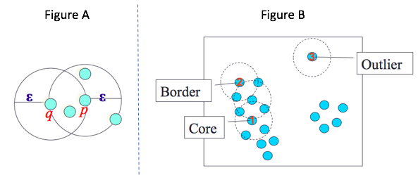
The algorithm have two measures
ϵ-Neighborhood: all points with a radius of ϵ from point q. If a point has many points in its ϵ-radius, the density in that radius is high. Thus the name density-based comes from.

Slide 7
The algorithm have two measures
p: minimum number of points in the given neighborhood. Each point can be a core point if it its density is high, or a border point if its density is low but still in the neighborhood of a core point, or a noise point that is not a core nor a border point.

Slide 8
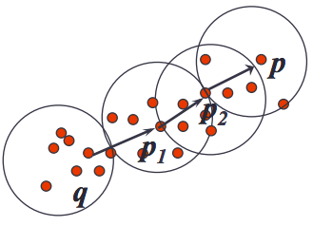
Any directions - density-reachable
DBSCAN can cluster points by reaching out in any direction as long as a another point p is in q's ϵ-neighborhood or directly density-reachable from q.
p1 is directly density-reachable from q, p2 is directly density-reachable from p1, and so on until all q,p1,p2,p are clustered together. Thus it can develop clusters of arbitrary shape in spatial databases with noise.
This site has nice visualization.

